Slide 1

ASSIGENMENT about
Introduction to design
BBA 1st SEM (2022-23)
Submitted By-
Shankh Bansal
AU22C1013
Submitted To- Aditya Trivedi

Slide 2
Part 1

Slide 3

What is design ?
design refers to the path for achieving the objective.
design is a plan to make something.
design is the art of the possible.

Slide 4

Types of design
Product design.
Branding design.
Website design.
Print design.
Publishing design.
Environmental design.
Animation design.

Slide 5

Why is design important to business ?
Good design makes a strong first impression.
Good design helps your business stand out.
Good design builds customer relationships.
Good design makes you money.

Slide 6

What is empathy and why is it important is business?
empathy – the ability to understand things from another person's perspective.
Empathy boosts collaboration
Empathy increases productivity and competitive edge
Empathy leads to employee satisfaction

Slide 7
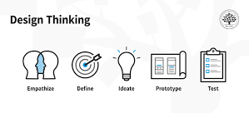
What is design thinking ?
Design thinking is an iterative process in which you seek to understand your users, it involve the following steps –
empathize
design
ideate
prototype
test

Slide 8
Part 2

Slide 9
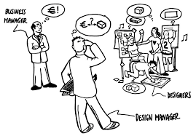
What is design management ?
Creating a design brief based on client or company needs.
Training and supporting the design management team.
working across teams to meet business goals.

Slide 10
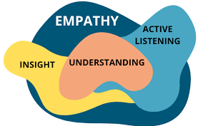
What is empathy and why is it important is business?
Empathy - improves human interactions in general and can lead to more effective communication and positive outcomes
Creates open communication environment.
Leads to trust and brand loyalty
Improves leadership skills.

Slide 11
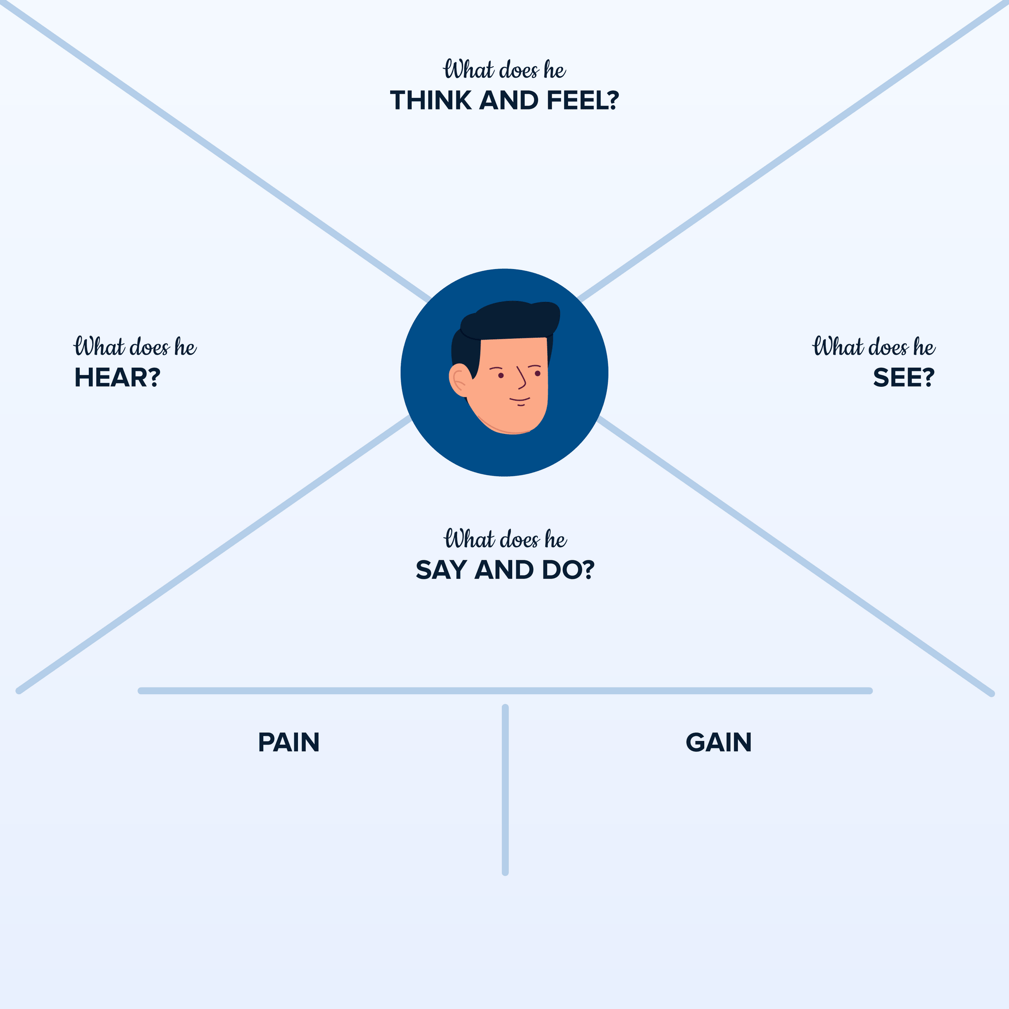
What is better for me?
Too many acronyms
Maybe this isn’t the best
E
M
P
A
T
H
Y
M
A
P
The cost will change soon
What is your budget
A lot of responsibility
TV commercials
Facebook
Instagram
Newspaper
What do you think?
What brand do you like?
What size is best?
Fear
Excited
Anxious
She looking for a good deal.
Sense of responsibility.
felling of accomplishment.

Slide 12

What are the different aspects of design management?
Leadership
Administration
Management
Education
Knowledge
Experience

Slide 13
Part 3

Slide 14
About apple
Apple is an American company founded by Steve jobs, Steve wozanik, Ronald Wayne in California.
Founded in 1976.
Specialization in hardware and software.
Computers are using operating system called os x and touch device has iOS.
Most famous software : iTunes, iWork, ilife.

Slide 15
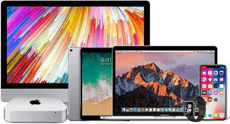
Product line
The most famous products :
MAC- computers
IPod
IPhone
iPad
apple watches

Slide 16
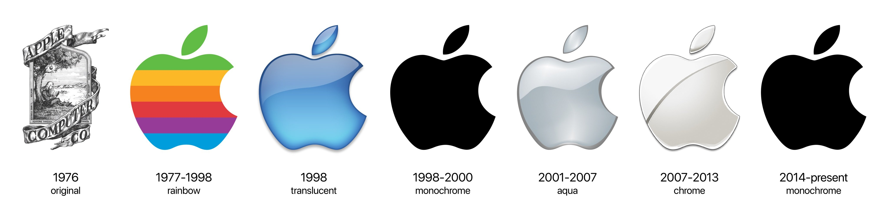
history of apple logo
There are many legends about the name
A) story of Isaac newton
b) name of the logo came from Steve jobs diet.

Slide 17
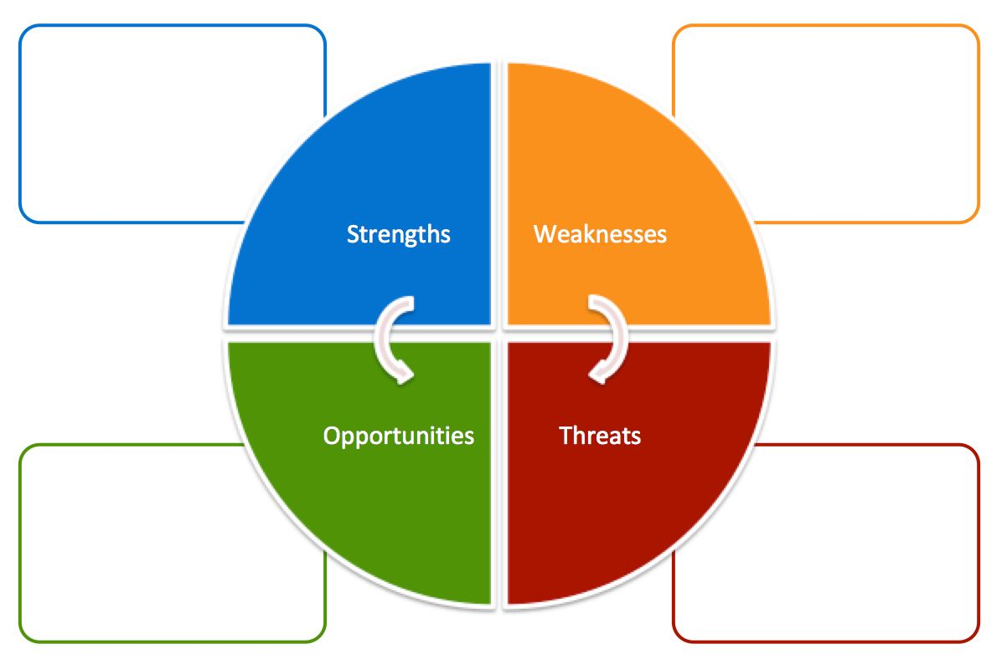
54% OF apple profits are in foreign market.
Knowledge of customer based.
High quality products.
Brand name.
Innovations.
High price.
Quality product control.
Poor leadership quality.
No dividends.
the scale of LBO.
Enlarge target market with new product “Nike” .
Integrated with other products “cars” .
The use of intel chips.
Developing iTunes.
High level of competition in technology market.
High product substitution effects.

Slide 18
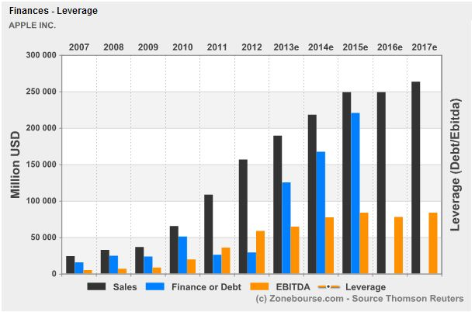
Financial ratio analysis

Slide 19
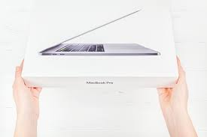
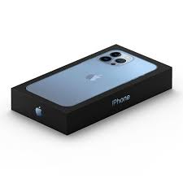
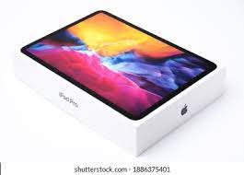
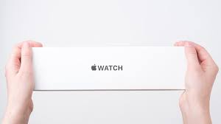
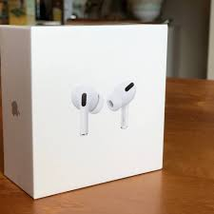
What are the design element that we observe in apple ?
Simplicity
Clean
Straight forward

Slide 20
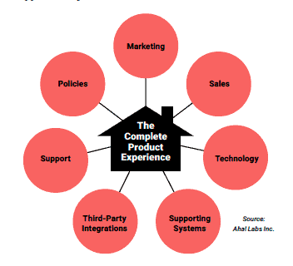
Elements
Purpose-driven.
Unique.
Knows its target market.
Stays on-brand at all times.
Authentic.
Thick-skinned.

Slide 21
Biggest competitor (Samsung)
Samsung is a south Korean multinational company.
Headquartered in Samsung town, Seoul.
Samsung was founded by lee byung-chul in 1938,as a trading company.
Samsung entered the electronics industry in late 1960.
By 2004 Samsung was the world largest manufacturer of oled, with 40% of market share.

Slide 22
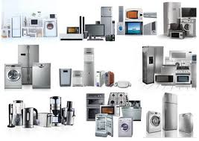
Product line

Slide 23



Small product line.
Total valuation 2trillion $.
No 1 in smart phone market.
High share valve.
High people trust.
Innovators.
Long service provider.
Target only Porsha audience.
Large product line.
Total valuation 501 billion $.
Holds 2nd position in smart phone market.
Low share value.
Blind trust is not earned yet.
Moderate service provider.
Targets all the people.

Slide 24


